Slide 1
Department of Computer Science
CS F364 – DESIGN AND ANALYSIS OF ALGORITHMS
LECTURE 1,2, and 3
As specified in handout and the contents taught in class. Class notes is must. Refer to the textbook as mentioned in handout
PLEASE NOTE THAT PPT IS JUST AN ADDITIONAL REFERENCE.

Slide 2
Topics- Lecture 1,2,3
LECTURE 1 | Introduction to algorithms, Refresh Asymptotic notation, Refresh order of growth of algorithm | Introduction, Space Complexity, Time Complexity, One Example in Big Oh, Big Omega, Theta related to tutorial. Refer T1: Chapter: 3
LECTURE 2 | Divide Conquer -Calculating the complexity of a binary search algorithm, Explain recursive and non-recursive algorithm | 1. Refer R2: 3.1, 3.3 2. Refer T1: Chapter: 4 for recursive and non-recursive algorithm
LECTURE 3 | Solving recurrence equations with one example (Recursion Tree, problem in corman at pg no: 63 and 69) | 1. Solve: T(n)=2T(n/2)+n using recursion tree. T(n)=3T(n/4)+n² using recursion tree.

Slide 3
Algorithm Analysis
Analysis of algorithm is the process of analyzing the problem-solving capability of the algorithm in terms of the time and size required (the size of memory for storage while implementation). However, the main concern of analysis of algorithms is the required time or performance. Generally, we perform the following types of analysis −
Worst-case − The maximum number of steps taken on any instance of size a.
Best-case − The minimum number of steps taken on any instance of size a.
Average case − An average number of steps taken on any instance of size a.
Amortized − A sequence of operations applied to the input of size a averaged over time.

Slide 4
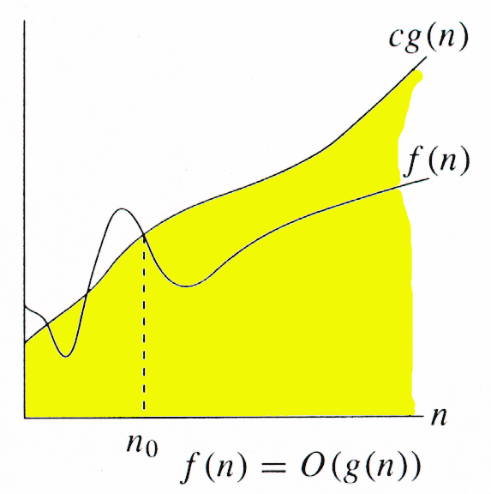
Asymptotic Notation - O-notation
For function g(n), we define O(g(n)), big-O of n, as the set:
O(g(n)) = {f(n) : ∃ positive constants c and n_{0,} such that ∀n ≥ n₀,
we have 0 ≤ f(n) ≤ cg(n) }
Intuitively: Set of all functions whose rate of growth is the same as or lower than that of g(n).
g(n) is an asymptotic upper bound for f(n).
f(n) = Θ(g(n)) ⇒ f(n) = O(g(n)).
Θ(g(n)) ⊂ O(g(n)).

Slide 5
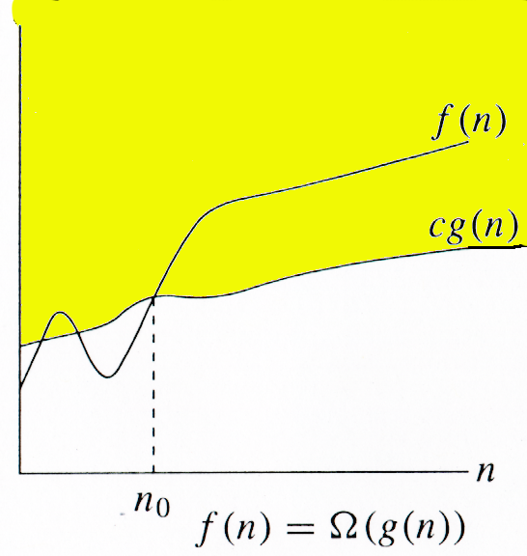
Ω -notation
For function g(n), we define Ω(g(n)), big-Omega of n, as the set:
Ω(g(n)) = {f(n) : ∃ positive constants c and n_{0,} such that ∀n ≥ n₀,
we have 0 ≤ cg(n) ≤ f(n)}
Intuitively: Set of all functions whose rate of growth is the same as or higher than that of g(n).
g(n) is an asymptotic lower bound for f(n).
f(n) = Θ(g(n)) ⇒ f(n) = Ω(g(n)).
Θ(g(n)) ⊂ Ω(g(n)).

Slide 6
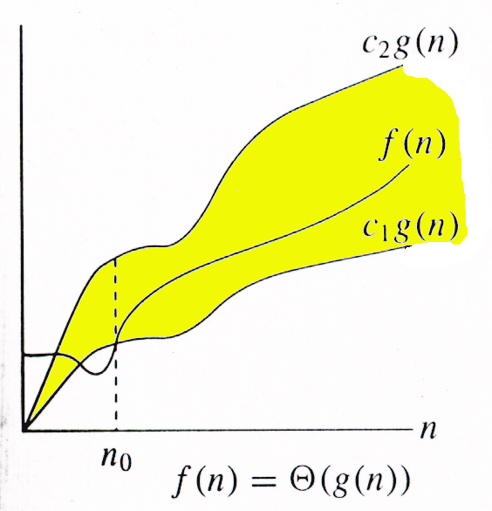
Θ-notation
For function g(n), we define Θ(g(n)), big-Theta of n, as the set:
Θ(g(n)) = {f(n) : ∃ positive constants c₁, c₂, and n_{0,} such that ∀n ≥ n₀,
we have 0 ≤ c₁g(n) ≤ f(n) ≤ c₂g(n)
}
Technically, f(n) ∈ Θ(g(n)).
Older usage, f(n) = Θ(g(n)).
I’ll accept either…
f(n) and g(n) are nonnegative, for large n.

Slide 7
Big O-notation – Definition
g(N) = O(f(N)) (read g(N) is said to be O(f(N))) iff there exist constants c₀ and N₀ such that 0 ≤ g(N) ≤ c₀ f(N) for all N >N₀

Slide 8
Big-O Notation - Examples
Uses
To bound the error that we make when we ignore small terms in mathematical formulas
Allows us to focus on leading terms
Example:
N² + 3N + 4 = O(N²), since N² + 3N + 4 < 2N² for all n > 10
N² + N + N lg N + lg N + 1 = O(N ²)
To bound the error that we make when we ignore parts of a program that contribute a small amount to the total being analyzed
To allow us to classify algorithms according to the upper bounds on their total running times

Slide 9
Ω(f(n)) and Θ(f(n)) – Definition
g(N) = Ω(f(N)) (read g(N) is said to be Ω(f(N))) iff there exist constants c₀ and N₀ such that 0 ≥ g(N) ≥ c₀ f(N) for all N >N₀
g(N) = Θ(f(N)) (read g(N) is said to be Ω(f(N))) iff there exist constants c₀, c₁ and N₀ such that c₁ f(N) ≥ g(N) ≥ c₁ f(N) for all N >N₀

Slide 10
Analysis of algorithm
Empirical analysis
Implement the algorithm
Input and other factors
Run empirical tests – Best Case, Worst Case, Average Case
Mathematical analysis
To compare different algorithms
To predict performance in a new environment
To set values of algorithm parameters

Slide 11
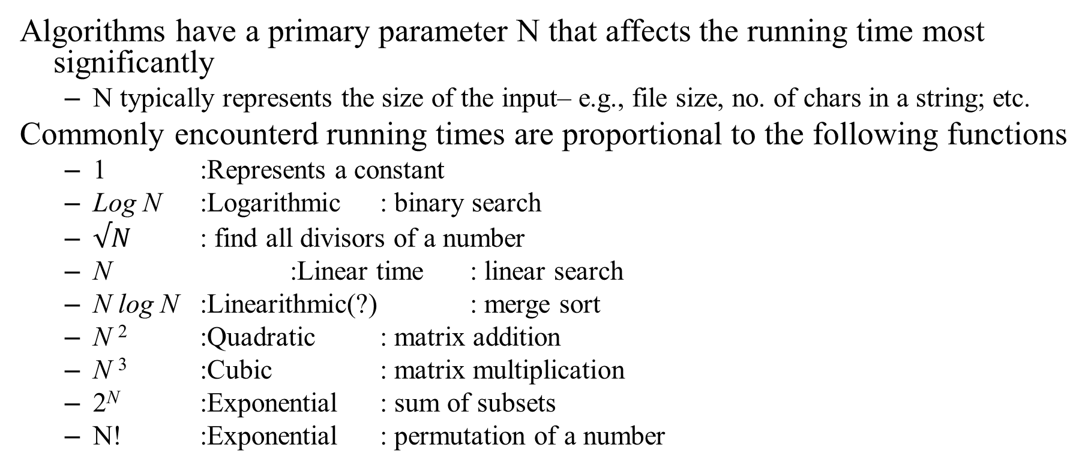
Growth of functions
Algorithms have a primary parameter N that affects the running time most significantly
N typically represents the size of the input– e.g., file size, no. of chars in a string; etc.
Commonly encounterd running times are proportional to the following functions
1 :Represents a constant
Log N :Logarithmic : binary search
$√N$ : find all divisors of a number
N :Linear time : linear search
N log N :Linearithmic(?) : merge sort
N ² :Quadratic : matrix addition
N ³ :Cubic : matrix multiplication
2^{N} :Exponential : sum of subsets
N! :Exponential : permutation of a number

Slide 12
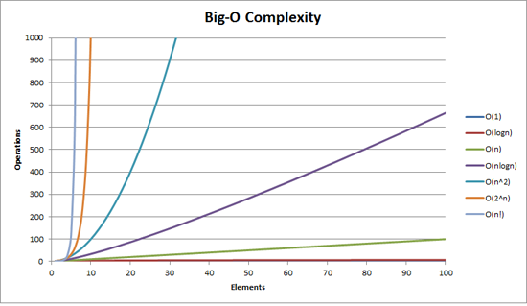
Growth of functions

Slide 13
Function values
lg N | N ^{0.5} | N | N lg N | N (lg N ) ² | N ² | 2^{N}
3 | 3 | 10 | 33 | 110 | 100 | 1042
7 | 10 | 100 | 664 | 444 | 10000 | 2^{10x10}= 1042¹⁰
10 | 32 | 1000 | 9966 | 99317 | 1000000 | ?
13 | 100 | 10000 | 132877 | 1765633 | 100000000 | ?
17 | 316 | 100000 | 1660964 | 27588016 | 10000000000 | ?
20 | 1000 | 1000000 | 19931569 | 397267426 | 1000000000000 | ?

Slide 14
Divide-and-Conquer
The most-well known algorithm design strategy:
Divide instance of problem into two or more smaller instances
Solve smaller instances recursively
Obtain solution to original (larger) instance by combining these solutions

Slide 15
Divide-and-Conquer Technique (cont.)
a problem of size n
(instance)
subproblem 1
of size n/2
subproblem 2
of size n/2
a solution to
subproblem 1
a solution to
subproblem 2
a solution to
the original problem
It general leads to a recursive algorithm!

Slide 16
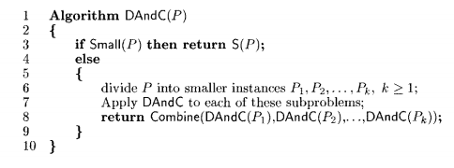
Divide-and-Conquer Algorithm

Slide 17
Divide-and-Conquer Examples
Binary search
Min Max Algorithm
Sorting: mergesort and quicksort

Slide 18
Binary Search
Binary search. Given value and sorted array a[], find index i such that a[i] = value, or report that no such index exists.
Invariant. Algorithm maintains a[lo] ≤ value ≤ a[hi].
Ex. Binary search for 33.
6
13
14
25
33
43
51
53
64
72
84
93
95
96
97
0
1
2
3
4
5
6
7
8
9
10
11
12
13
14
lo
hi

Slide 19
Binary Search
Binary search. Given value and sorted array a[], find index i such that a[i] = value, or report that no such index exists.
Invariant. Algorithm maintains a[lo] ≤ value ≤ a[hi].
Ex. Binary search for 33.
6
13
14
25
33
43
51
53
64
72
84
93
95
96
97
0
1
2
3
4
5
6
7
8
9
10
11
12
13
14
lo
mid
hi

Slide 20
Binary Search
Binary search. Given value and sorted array a[], find index i such that a[i] = value, or report that no such index exists.
Invariant. Algorithm maintains a[lo] ≤ value ≤ a[hi].
Ex. Binary search for 33.
6
13
14
25
33
43
51
53
64
72
84
93
95
96
97
0
1
2
3
4
5
6
7
8
9
10
11
12
13
14
lo
hi

Slide 21
Binary Search
Binary search. Given value and sorted array a[], find index i such that a[i] = value, or report that no such index exists.
Invariant. Algorithm maintains a[lo] ≤ value ≤ a[hi].
Ex. Binary search for 33.
6
13
14
25
33
43
51
53
64
72
84
93
95
96
97
0
1
2
3
4
5
6
7
8
9
10
11
12
13
14
lo
mid
hi

Slide 22
Binary Search
Binary search. Given value and sorted array a[], find index i such that a[i] = value, or report that no such index exists.
Invariant. Algorithm maintains a[lo] ≤ value ≤ a[hi].
Ex. Binary search for 33.
6
13
14
25
33
43
51
53
64
72
84
93
95
96
97
0
1
2
3
4
5
6
7
8
9
10
11
12
13
14
lo
hi

Slide 23
Binary Search
Binary search. Given value and sorted array a[], find index i such that a[i] = value, or report that no such index exists.
Invariant. Algorithm maintains a[lo] ≤ value ≤ a[hi].
Ex. Binary search for 33.
6
13
14
25
33
43
51
53
64
72
84
93
95
96
97
0
1
2
3
4
5
6
7
8
9
10
11
12
13
14
lo
mid
hi

Slide 24
Binary Search
Binary search. Given value and sorted array a[], find index i such that a[i] = value, or report that no such index exists.
Invariant. Algorithm maintains a[lo] ≤ value ≤ a[hi].
Ex. Binary search for 33.
6
13
14
25
33
43
51
53
64
72
84
93
95
96
97
0
1
2
3
4
5
6
7
8
9
10
11
12
13
14
lo hi

Slide 25
Binary Search
Binary search. Given value and sorted array a[], find index i such that a[i] = value, or report that no such index exists.
Invariant. Algorithm maintains a[lo] ≤ value ≤ a[hi].
Ex. Binary search for 33.
6
13
14
25
33
43
51
53
64
72
84
93
95
96
97
0
1
2
3
4
5
6
7
8
9
10
11
12
13
14
lo hi mid

Slide 26
Binary Search
Binary search. Given value and sorted array a[], find index i such that a[i] = value, or report that no such index exists.
Invariant. Algorithm maintains a[lo] ≤ value ≤ a[hi].
Ex. Binary search for 33.
6
13
14
25
33
43
51
53
64
72
84
93
95
96
97
0
1
2
3
4
5
6
7
8
9
10
11
12
13
14
lo hi mid

Slide 27
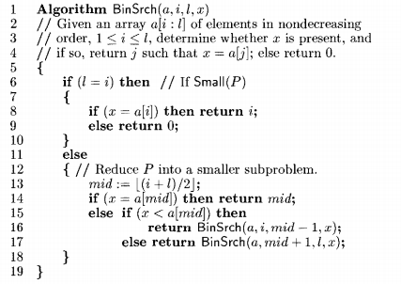

Recursive Binary Search algorithm

Slide 28
Recursive Binary Search algorithm – Time Complexity
For Binary Search, T(N) = T(N/2) + O(1) // the recurrence relation
Divide N by 2 until you have 1 element. This is essentially saying, do a binary search (half the elements) until you found it. In a formula this would be this:
1= N / 2^{x}
2^{x} = N
log₂(2^{x}) = log₂ N
x * 1 = log₂ N

Slide 29
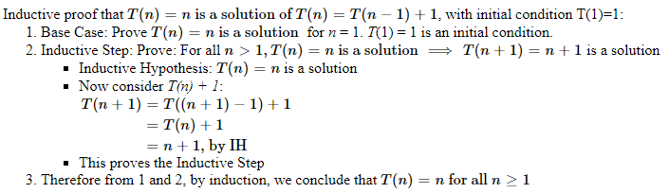
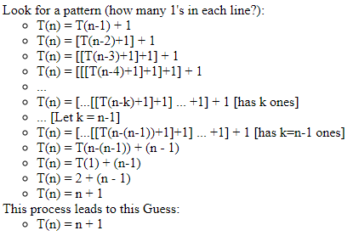
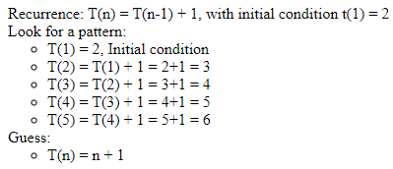
Ways of Solving Recurrence Relation
Mathematical Induction
Mathematical Induction
Substitution Method
Recursion Tree
Masters Theorem
Backward Substitution
Forward Substitution

Slide 30
Recursive Vs Non – Recursive Algorithm Basic Recurrences
Non recursive equation examples: T(n)=n⁴ + 3n — 1, T(n)=n²
Principle of recursive decomposition
decomposition of problems into one or more smaller ones of the same type
Use solutions for the sub-problems to get solution of the problem
Example 1:
Loops through a loop and eliminates one item
C_{N} = C_{N-1} + N, for N ≥ 2 with C₁ = 1
= C_{N-2} + (N-1) + N
= C_{N-3} + (N-2) + (N-1) + N
…
= 1 + 2 + … + (N-2) + (N-1) + N = N (N+1)/2
Therefore, C_{N} = O(N²)

Slide 31
Recursive Vs Non – Recursive Algorithm Basic Recurrences
Recurrence relations
Captures the dependence of the running time of an algorithm for an input of size N on its running time for small inputs
Example 2:
formula for recursive programs for that halves the input in one step
C_{N} = C_{N/2} + 1, for N ≥ 2 with C₁ = 1; let C_{N} = lg N , and N = 2^{n.}
= C_{N/2} + 1 + 1
= C_{N/4} + 1 + 1 + 1
…
= C_{N/N} + n = 1 + n
Therefore, C_{N} = O(n) = O(lg N )

Slide 32
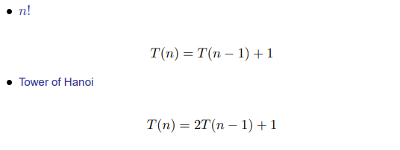
Recursive Equations

Slide 33
Recursion algorithm using Recursion tree Merge Sort
Solve T(n) = 2T(n/2) + cn, where c > 0 is constant.

Slide 34
Recursion tree
Solve T(n) = 2T(n/2) + cn, where c > 0 is constant.
T(n)

Slide 35
Recursion tree
Solve T(n) = 2T(n/2) + cn, where c > 0 is constant.
cn
T(n/2)
T(n/2)

Slide 36
Recursion tree
Solve T(n) = 2T(n/2) + cn, where c > 0 is constant.
cn
cn/2
cn/2
T(n/4)
T(n/4)
T(n/4)
T(n/4)

Slide 37
Recursion tree
Solve T(n) = 2T(n/2) + cn, where c > 0 is constant.
cn
cn/2
cn/2
cn/4
cn/4
cn/4
cn/4
…
Θ(1)

Slide 38
Recursion tree
Solve T(n) = 2T(n/2) + cn, where c > 0 is constant.
cn
cn/2
cn/2
h = lg n
cn/4
cn/4
cn/4
cn/4
…
Θ(1)

Slide 39
Recursion tree
Solve T(n) = 2T(n/2) + cn, where c > 0 is constant.
cn
cn
cn/2
cn/2
h = lg n
cn/4
cn/4
cn/4
cn/4
…
Θ(1)

Slide 40
Recursion tree
Solve T(n) = 2T(n/2) + cn, where c > 0 is constant.
cn
cn
cn/2
cn/2
cn
h = lg n
cn/4
cn/4
cn/4
cn/4
…
Θ(1)

Slide 41
Recursion tree
Solve T(n) = 2T(n/2) + cn, where c > 0 is constant.
cn
cn
cn/2
cn/2
cn
h = lg n
cn/4
cn/4
cn/4
cn/4
cn
…
…
Θ(1)

Slide 42
Recursion tree
Solve T(n) = 2T(n/2) + cn, where c > 0 is constant.
cn
cn
cn/2
cn/2
cn
h = lg n
cn/4
cn/4
cn/4
cn/4
cn
…
…
Θ(1)
#leaves = n
Θ(n)

Slide 43
Recursion tree
Solve T(n) = 2T(n/2) + cn, where c > 0 is constant.
cn
cn
cn/2
cn/2
cn
h = lg n
cn/4
cn/4
cn/4
cn/4
cn
…
…
Θ(1)
#leaves = n
Θ(n)
Total = Θ(n lg n)

Slide 44
Recursion tree – To try T(n) =3T(n/4)+cn2

Slide 45
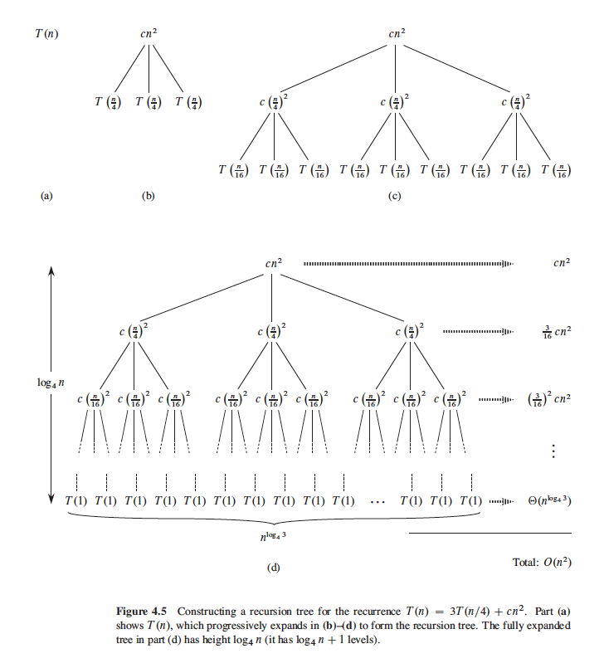

Slide 46
Thank You

